Slide 1
Introduction to Stack
Lecture #
By: Abdul Aleem

Slide 2
Contents
1 Introduction
2 Stack Concepts
3 Basic Features of Stack
4 Operations on Stack
5
Last In First Out(LIFO)
6
Push operations on stack
7
Pop operations on stack
8
Display operations of stack
9
Stack overflow vs Stack underflow

Slide 3
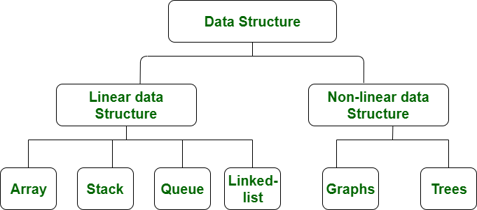
Introduction
Stack:
Stack is a linear data structure.
Stack is a data structure in which insertion and deletion takes place at one end.
Figure 1: Types of Data Structure

Slide 4
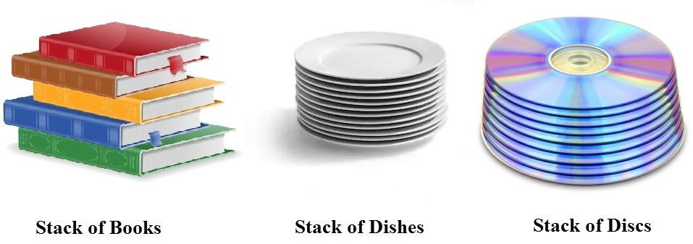
Stack Concepts
A real world examples for stack-a deck of cards,a pile of plates, or a stack of books.
Figure 2: Stack examples

Slide 5
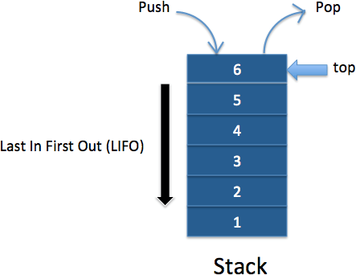
Basic Features of Stack
Stack is an Abstract Data struc- ture(ADT) works on the principle of Last In First Out(LIFO).
An abstract data type in a theo- retical construct that consists of data as well as the operations to be performed on the data while hiding implementation.
The last element add to the stack is the first element to be deleted.
Insertion and deletion can be takes place at one end called TOP.
Figure 3: Stack LIFO

Slide 6
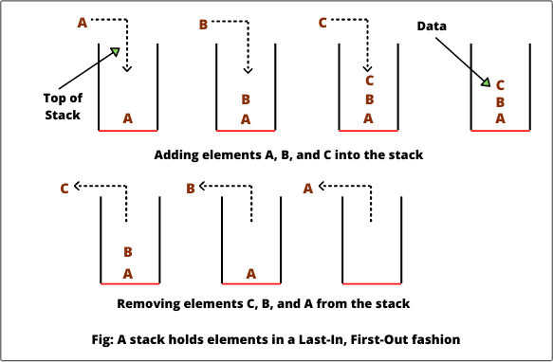
Basic features of Stack (contd..)
Stack Insert and Delete:
As the items can be added or removed only from the top i.e. the last item to be added to a stack is the first item to be re- moved.
The two basic operations associated with stacks are:
Push: to insert an element into stack
Pop: to delete an element from a
stack
Figure 4: Stack PUSH and POP operation

Slide 7
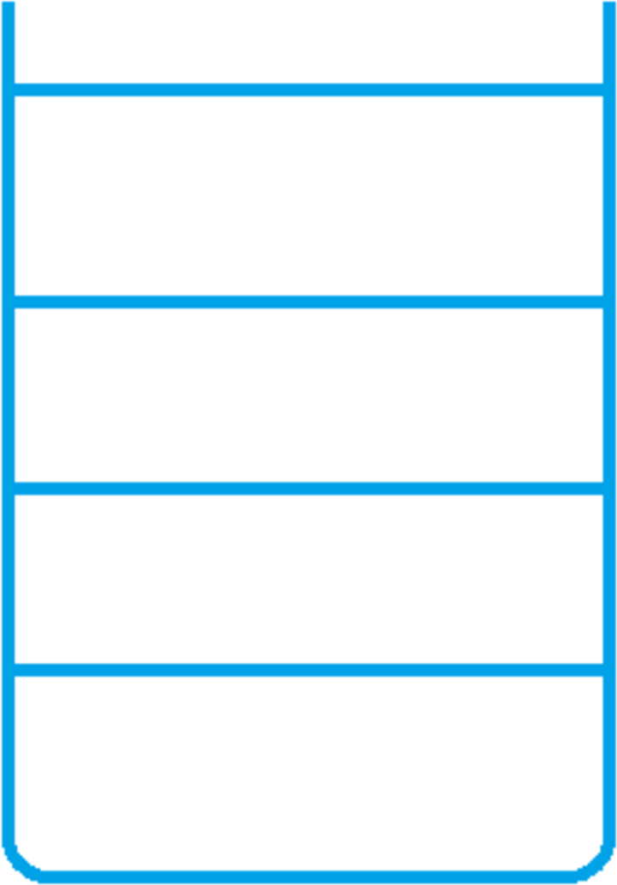
Basic features of Stack (contd..)
Empty Stack:
In an Empty stack the stack pointer(top) points to the next free (empty) location on the stack, i.e. the place where the next item to be pushed onto the stack will be stored.
Figure 5: Empty Stack

Slide 8

Basic features of Stack (contd..)
Full Stack:
In a Full stack the stack pointer(top) points to the top most item on the stack, i.e. the location of the last item to be pushed onto the stack.
Figure 6: Full Stack

Slide 9
Operations on Stack
Push: To insert an element in a stack.
Pop: To delete an element from the stack.
Display: To display elements of the stack.
isFull: To check if the stack is full.
isEmpty: To check if the stack is empty.

Slide 10
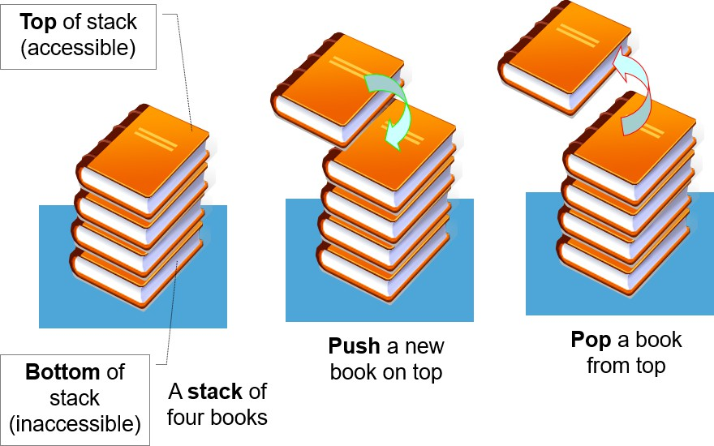
Last In First Out(LIFO)
Stack is a LIFO(Last In First Out)
structure.
In a stack, when an element is added (PUSH),it goes on to the Top of the stack and when an element is deleted (POP), it goes out from the Top of the stack.
Figure 7: LIFO in Stack

Slide 11
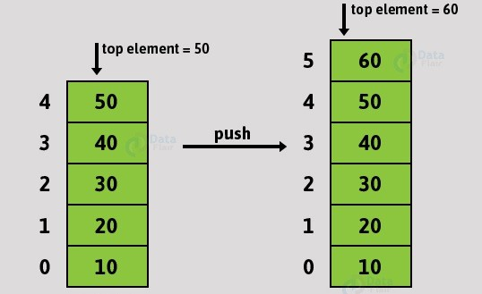
Push operations on stack
Push(): To insert an element in the stack.
Figure 8: PUSH operation in Stack

Slide 12
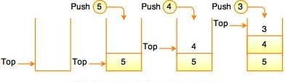
Push operations on stack(Example
Figure 9: Insertion of elements in Stack

Slide 13
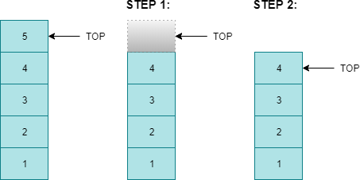
Pop operations on stack
Pop(): To delete an element from the stack.
Figure 10: POP operation in Stack

Slide 14
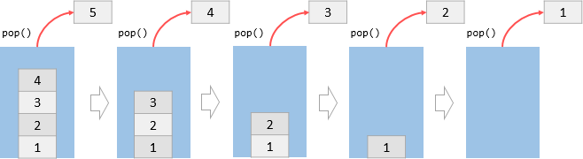
Pop operations on stack (Example)
Figure 11: Deletion of elements in Stack

Slide 15
Display operations of stack
Peek()/Display(): To display top element of the stack.
It is used to retrieve or fetch the first element of the Stack or the element present at the TOP of the Stack .
The element retrieved does not get deleted or removed from the Stack.
If we want to display all the elements of stack then we need to PEEK and POP each element of stack till the stack is empty.
Beyond this inherent attribute of Stack associated with TOP, we can traverse the elements one by one from top till the bottom of the stack i.e. still the stack is empty to display the stack elements. But this approach is implementation depen- dent and distinct for static as well dynamic implementations.

Slide 16
isFull()
isFull(): To check if stack is full.
Figure 12: Stack isFull=TRUE

Slide 17
isEmpty()
isEmpty(): To check if stack is empty.
Figure 13: Stack isEmpty=TRUE

Slide 18
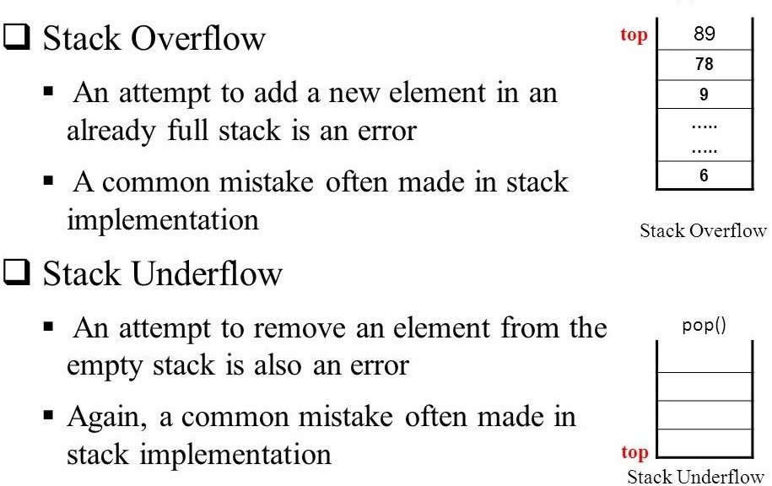
Stack overflow Vs Stack underflow

Slide 19
[1] Goodrich and Tamassia ‘Data Structures and Algorithms in java’, Wiley, India.
Reference

